Slide 1
Domain-specific languages for finance in F#
Tomas Petricek
University of Cambridge
http://tomasp.net

Slide 2
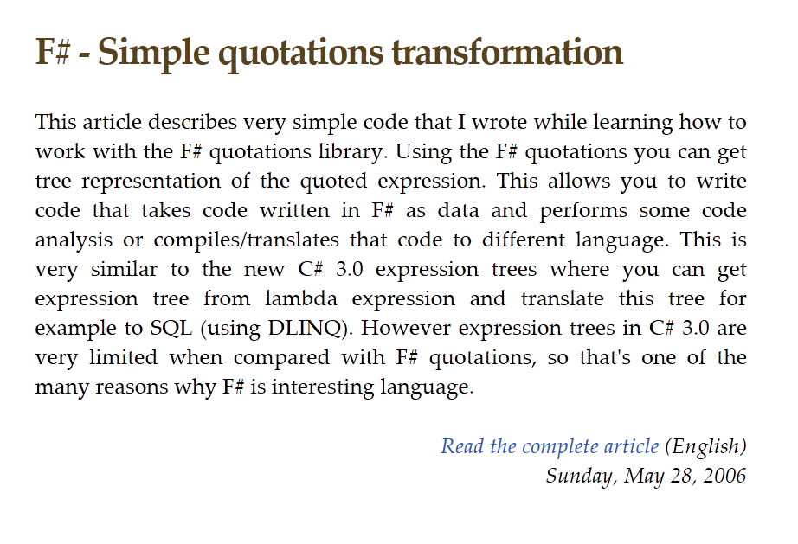


Slide 3
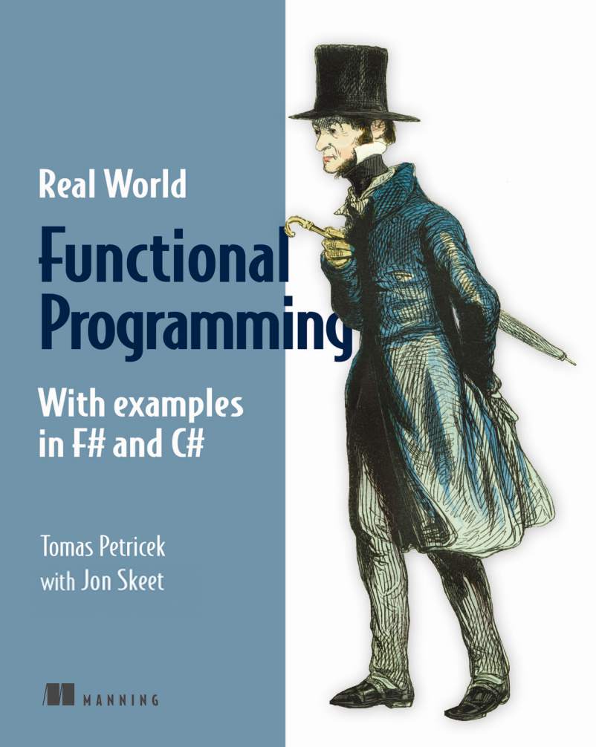

Slide 4
What are domain-specific languages and why?

Slide 5
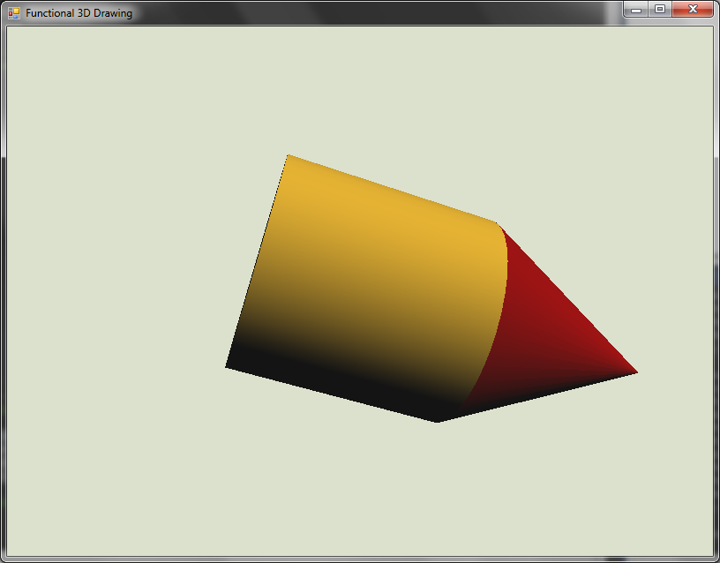
Domain-specific languages
Language for solving specific problems
Contrast with general purpose languages
Fun.cube
Fun.cylinder
|> Fun.translate (0.0, 0.0, 1.0)
|> Fun.color Color.Goldenrod $
Fun.cone
|> Fun.color Color.DarkRed

Slide 6
Domain-specific languages
We have a class of problems
Create a language for the class
Use language to solve them
Functional languages
Internal DSL is just an F# library
Flexible syntax and type checking
External DSL is a stand-alone langauge

Slide 7
First Example: Modeling financial contracts

Slide 8
Modeling Financial Contracts
Write contracts using simple primitives
What can happen on a specific date?
Valuation and risk assessment
let itcontract =
sellOn
(DateTime(2012, 4, 30)) ("MSFT", 23.0) $
purchaseRepeatedly
(DateTime(2012, 4, 23))
(TimeSpan.FromDays(7.0))
10 ("AAPL", 220.0)

Slide 9
Demo: Modeling Contracts http://fssnip.net/bJ
Notes:
TODO: Show how to create some contracts & how to test what can happen when

Slide 10
Simplifying the example
Date after and until specified
Repeatedly compose trades
let onDate dt contract =
after dt (until dt contract)
let repeatedly start span times contract =
[ for n in 0 .. times ->
let offs = TimeSpan(span.Ticks * int64 n)
onDate (start + offs) contract ]
|> Seq.reduce ($)

Slide 11
What are the primitives?
Captured as discriminated union
Can be processed in multiple ways
Only handle five cases!
type Contract =
| Trade of string * float
| Opposite of Contract
| After of DateTime * Contract
| Until of DateTime * Contract
| Combine of Contract * Contract

Slide 12
Demo: Processing contracts
Notes:
TODO: What are the time limits? When can any trade of the contract happen?

Slide 13
Domain-specific languages
Using discriminated unions
Defines the language
Limits the expressivity
Simplify common uses
Multiple processing functions
Using function values

Slide 14
Second Example: Detecting patterns in price changes

Slide 15
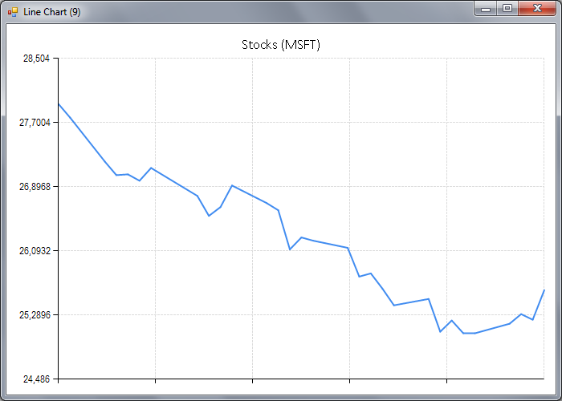
Declining pattern

Slide 16
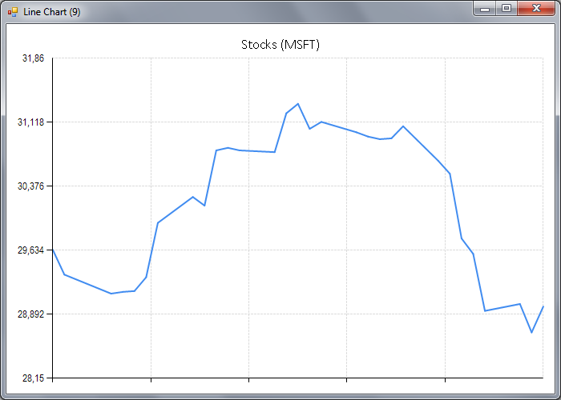
Rounding top pattern

Slide 17
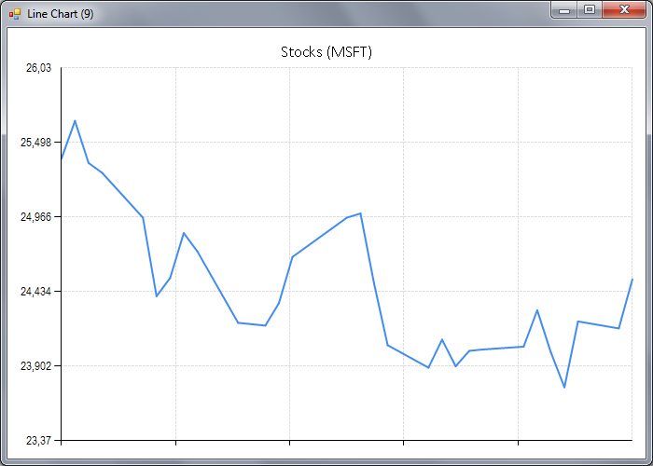
Multiple bottom pattern

Slide 18
Doman-specific language approach
Primitive classifiers
Declining price
Rising price
Combinators for classifiers
Average using regression
Sequence multiple patterns
Check patterns in parallel

Slide 19
Demo: Classifier DSL http://fssnip.net/bK

Slide 20
DSL for price patterns
Conditions on subsequent parts
Run classifier over linear regression
Run two classifiers and combine values
Check that both conditions hold
sequenceAnd rising declining
regression declining
both minimum maximum |> map (fun (l, h) -> h - l)
bothAnd declining (inRange 20.0 25.0)

Slide 21
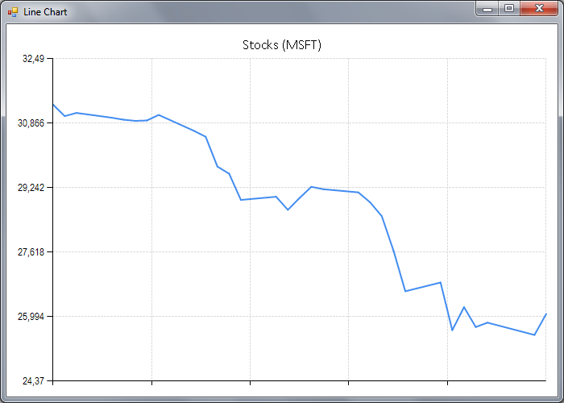
Demos and Tasks
Double bottom pattern
Change over regression
Down–Up two times
Declining fast pattern
Declining over regression
(Max – Min) > 3 USD

Slide 22
How does it work?
What is a classifier?
A function value!
Given data, calculate the result
Generic – can produce anything
Abstract – only internal
type Classifier<'T> =
ClassifyFunc of ((DateTime * float)[] -> 'T)

Slide 23
Complex from simple
Check multiple conditions
Calculate minimum value
All values are in a range
let bothAnd a b =
both a b |> map (fun (a, b) -> a && b)
let minimum =
reduce min |> map (fun v -> Math.Round(v, 2))
let inRange min max =
bothAnd (atLeast min) (atMost max)

Slide 24
Domain-specific languages
Using discriminated unions
Using function values
Defines the representation
Unlimited expressivity
Run the function to evaluate

Slide 25
Advanced domain-specific language topics

Slide 26
Types and DSLs
Grammar for the language
How to compose primitives?
Other benefits
Editor IntelliSense
Useful documentation
average : Classifier<float>
lessThan : float -> Classifier<float> -> Classifier<bool>

Slide 27
Repeating patterns
Repeating functions in DSLs
Map – transform the produced value
Merge – combine results of two tasks
Simplify using them? With language syntax?
('T -> 'R) -> Classifier<'T> -> Classifier<'R>
Classifier<'T1> -> Classifer<'T2> -> Classifer<'T1 * 'T2>

Slide 28
Computation expressions
Syntax for computations
For types with certain operations
Aka monads in Haskell
Declining without fluctuation
classify {
let! lLo, rHi =
sequence minimum maximum
let! down = declining
return down && (lLo >= rHi) }

Slide 29
Demo: Contract “Monad”

Slide 30
Conclusions

Slide 31
Conclusions
Domain-specific languages
Choose a class of problems
Design simple primitives
Use powerful composition
The F# language
Discriminated unions
Typed functional style

Slide 32

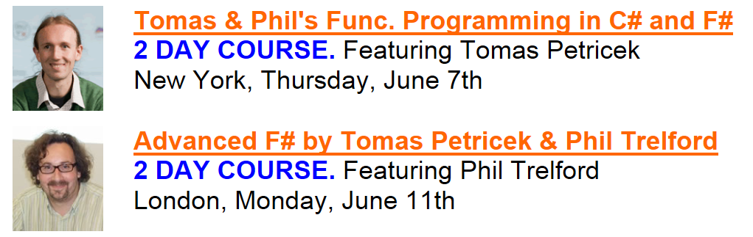
More F# in New York
Contact: tomas@tomasp.net

